Slide 1
Concurrency Control
Instructor: Dr. Sonam Nahar

Slide 2
Concurrency Control
When several transactions execute concurrently in the database, however, the isolation property may no longer be preserved.
To ensure that it is, the system must control the interaction among the concurrent transactions; this control is achieved through one of a variety of mechanisms called concurrency-control schemes.
In this chapter:
  We discuss concurrency-control schemes that are based on the serializability property.
  We ignore failures.

Slide 3
Lock-Based Protocols
One way to ensure serializability is to require that data items be accessed in a mutually exclusive manner; that is, while one transaction is accessing a data item, no other transaction can modify that data item.
The most common method is to allow a transaction to access a data item only if it is currently holding a lock on that item.
A lock is a mechanism to control concurrent access to a data item.
Data items can be locked in two modes :
1. exclusive (X) mode. Data item can be both read as well as written. X-lock is requested using lock-X instruction.
2. shared (S) mode. Data item can only be read. S-lock is requested using lock-S instruction.
Every transaction request a lock in an appropriate mode on data item Q depending on the types of operations that it will perform on Q.
Lock requests are made to concurrency-control manager. Transaction can proceed only after request is granted.

Slide 4

Lock-Based Protocols (Cont.)
Lock-compatibility matrix
A transaction may be granted a lock on an item if the requested lock is compatible with locks already held on the item by other transactions
Any number of transactions can hold shared locks on an item,
  but if any transaction holds an exclusive on the item no other transaction may hold any lock on the item.
If a lock cannot be granted, the requesting transaction is made to wait till all incompatible locks held by other transactions have been released. The lock is then granted.
A transaction can unlock a data item Q by the unlock(Q) instruction.

Slide 5
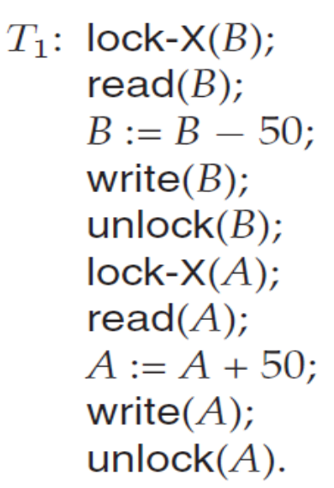
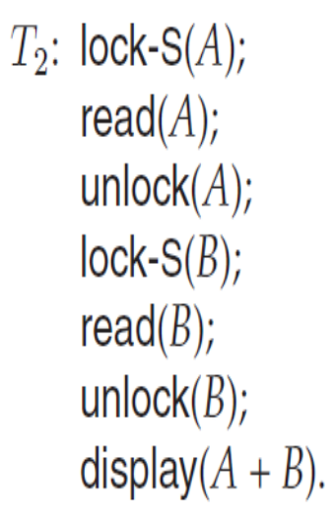
Lock-Based Protocols (Cont.)
Examples of transactions performing locking:
For a transaction to unlock a data item immediately after its final access of that data item is not always desirable, since serializability may not be ensured.
If these two transactions are executed serially then A+B s preserved.
If, however, these transactions are executed concurrently, then schedule 1 is possible.

Slide 6
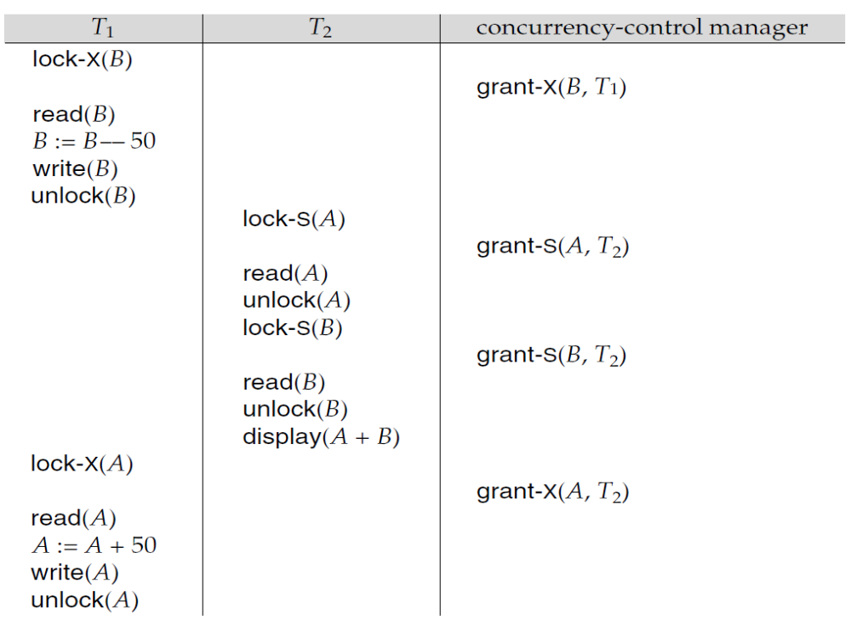
Lock-Based Protocols (Cont.)

Slide 7
Lock-Based Protocols (Cont.)
The schedule shows the actions executed by the transactions, as well as the points at which the concurrency-control manager grants the locks.
The lock must be granted in the interval of time between the lock-request operation and the following action of the transaction.
In the last example, transaction T1 unlocked data item B too early, as a result of which T2 saw an inconsistent state.

Slide 8
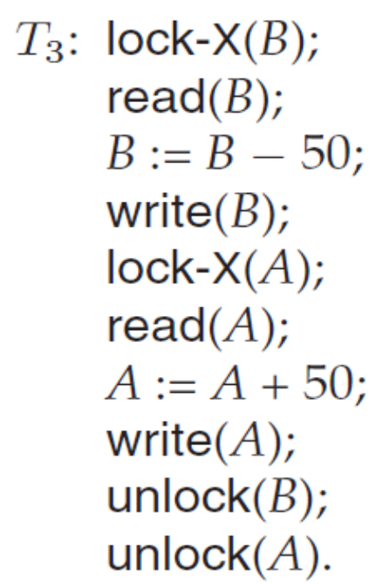
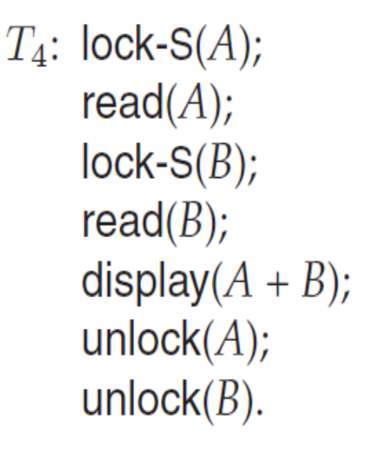
Lock-Based Protocols (Cont.)
Suppose now that unlocking is delayed to the end of the transaction.
Transaction T₃ corresponds to T₁ with unlocking delayed
Transaction T₄ corresponds to T₁ with unlocking delayed

Slide 9

Lock-Based Protocols (Cont.)
Consider the partial schedule
Neither T₃ nor T₄ can make progress — executing lock-S(B) causes T₄ to wait for T₃ to release its lock on B, while executing lock-X(A) causes T₃ to wait for T₄ to release its lock on A.
Such a situation is called a deadlock.
  To handle a deadlock one of T₃ or T₄ must be rolled back
  and its locks released.

Slide 10
Lock-Based Protocols (Cont.)
If we do not use locking, or if we unlock data items as soon as possible after reading or writing them, we may get inconsistent states. On the other hand, if we do not unlock a data item before requesting a lock on another data item, deadlocks may occur.
Deadlocks are definitely preferable to inconsistent states, since they can be handled by rolling back of transactions, whereas inconsistent states may lead to real-world problems that cannot be handled by the database system.
A locking protocol is a set of rules followed by all transactions while requesting and releasing locks. Locking protocols restrict the set of possible schedules.

Slide 11
Lock-Based Protocols (Cont.)
Let {T₀, T₁, . . ., T_{n}} be a set of transactions participating in a schedule S. We say that T_{i} precedes T_{j} in S, written T_{i} → T_{j}, if there exists a data item Q such that T_{i} has held lock mode A on Q, and T_{j} has held lock mode B on Q later, and comp(A,B) = false. If T_{i} → T_{j} , then that precedence implies that in any equivalent serial schedule,T_{i} must appear before T_{j} .
Here, conflicts between instructions correspond to noncompatibility of lock modes.
A schedule S is legal under a given locking protocol if S is a possible schedule for a set of transactions that follow the rules of the locking protocol.
A locking protocol ensures conflict serializability if and only if all legal schedules are conflict serializable.

Slide 12
Granting of Locks
Starvation is also possible if concurrency control manager is badly designed. For example:
  A transaction may be waiting for an X-lock on an item, while a sequence of other transactions request and are granted an S-lock on the same item.
  The same transaction is repeatedly rolled back due to deadlocks.
Concurrency control manager can be designed to prevent starvation.
When a transaction T_{i} requests a lock on a data item Q in a particular mode M, the concurrency-control manager grants the lock provided that:
  1. There is no other transaction holding a lock on Q in a mode that conflicts with M.
  2. There is no other transaction that is waiting for a lock on Q, and that made its lock request before T_{i}.

Slide 13
The Two-Phase Locking Protocol
This is a protocol which ensures conflict-serializable schedules.
This protocol requires that each transaction issue lock and unlock requests in two phases:
  Phase 1: Growing Phase
    transaction may obtain locks
    transaction may not release locks
  Phase 2: Shrinking Phase
    transaction may release locks
    transaction may not obtain locks
Initially, a transaction is in the growing phase.
For example, transactions T₃ and T₄ are two phase. On the other hand, transactions T₁ and T₂ are not two phase.
Note that the unlock instructions do not need to appear at the end of the transaction. For example, in the case of transaction T₃, unlock(B) can be moved to just after the lock-X(A) instruction, and still retain the two-phase locking property.

Slide 14
The Two-Phase Locking Protocol (Cont.)
The protocol assures serializability. It can be proved that the transactions can be serialized in the order of their lock points (i.e. the point where a transaction acquired its final lock).
Two-phase locking does not ensure freedom from deadlocks
Cascading roll-back is possible under two-phase locking. To avoid this, follow a modified protocol called strict two-phase locking. Here a transaction must hold all its exclusive locks till it commits/aborts.
Strict 2PL ensures that any data written by an uncommitted transaction are locked in exclusive mode until the transaction commits, preventing any other transaction from reading the data.
Rigorous two-phase locking is even stricter: here all locks are held till commit/abort. In this protocol transactions can be serialized in the order in which they commit.

Slide 15
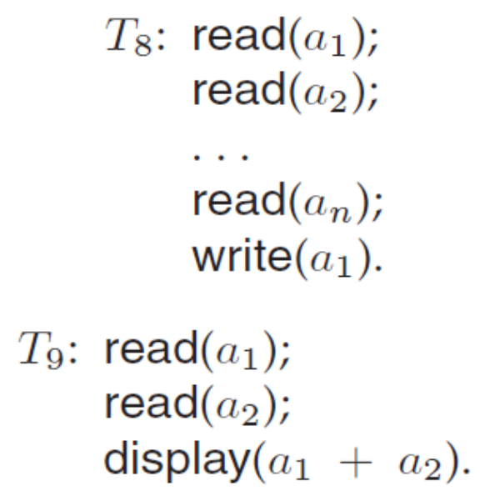
The Two-Phase Locking Protocol (Cont.)
If T₈ could initially lock a₁ in shared mode, and then could later change the lock to exclusive mode, we could get more concurrency, since T₈ and T₉ could access a₁ and a₂ simultaneously

Slide 16
Lock Conversions
Two-phase locking with lock conversions:
– First Phase:
  can acquire a lock-S on item
  can acquire a lock-X on item
  can convert a lock-S to a lock-X (upgrade)
– Second Phase:
  can release a lock-S
  can release a lock-X
  can convert a lock-X to a lock-S (downgrade)
This protocol assures serializability. But still relies on the programmer to insert the various locking instructions.
Note that a transaction attempting to upgrade a lock on an item Q may be forced to wait. This enforced wait occurs if Q is currently locked by another transaction in shared mode.

Slide 17
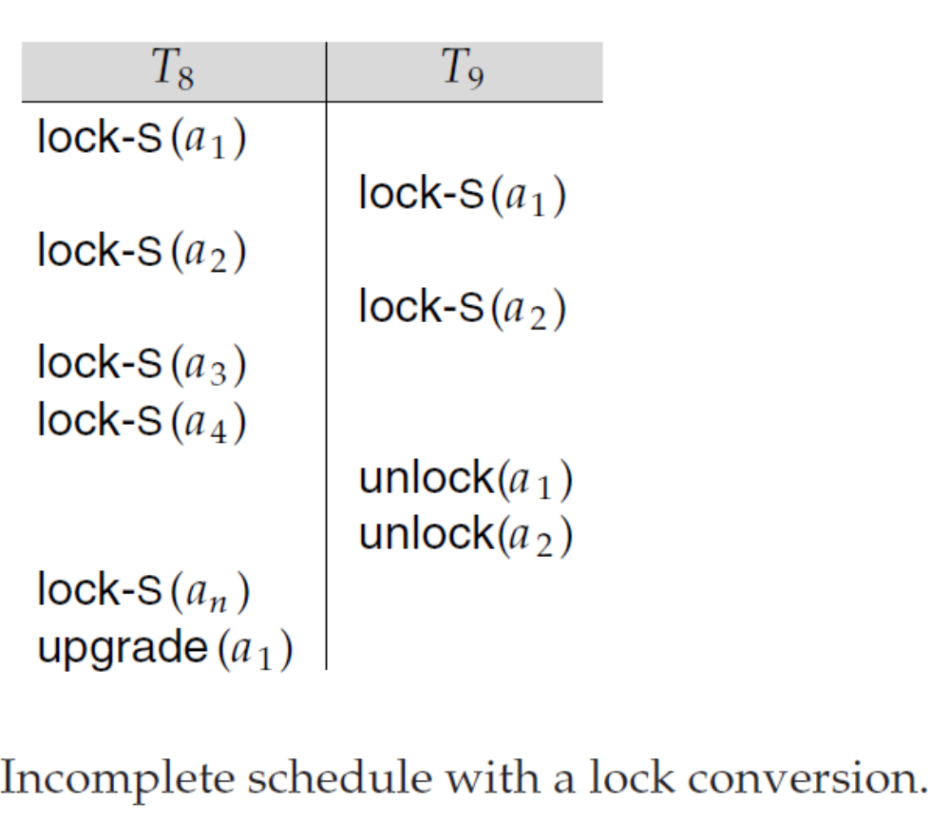
Lock Conversions

Slide 18
Automatic Acquisition of Locks
A transaction T_{i} issues the standard read/write instruction, without explicit locking calls.
The operation read(D) is processed as:
if T_{i} has a lock on D
then
read(D)
else begin
if necessary wait until no other
transaction has a lock-X on D
grant T_{i} a lock-S on D;
read(D)
end

Slide 19
Automatic Acquisition of Locks (Cont.)
write(D) is processed as:
if T_{i} has a lock-X on D
then
write(D)
else begin
if necessary wait until no other trans. has any lock on D,
if T_{i} has a lock-S on D
then
upgrade lock on D to lock-X
else
grant T_{i} a lock-X on D
write(D)
end;
All locks are released after commit or abort

Slide 20
Implementation of Locking
A lock manager can be implemented as a separate process to which transactions send lock and unlock requests
The lock manager replies to a lock request by sending a lock grant messages (or a message asking the transaction to roll back, in case of a deadlock)
The requesting transaction waits until its request is answered
The lock manager maintains a data-structure called a lock table to record granted locks and pending requests
The lock table is usually implemented as an in-memory hash table indexed on the name of the data item being locked

Slide 21

Lock Table
Black rectangles indicate granted locks, white ones indicate waiting requests
Lock table also records the type of lock granted or requested
New request is added to the end of the queue of requests for the data item, and granted if it is compatible with all earlier locks
Unlock requests result in the request being deleted, and later requests are checked to see if they can now be granted
If transaction aborts, all waiting or granted requests of the transaction are deleted
  lock manager may keep a list of locks held by each transaction, to implement this efficiently
Granted
Waiting

Slide 22
Deadlock Handling
Consider the following two transactions:
T₁: write (X) T₂: write(Y)
write(Y) write(X)
Schedule with deadlock
T₁
T₂
lock-X on X
write (X)
lock-X on Y
write (X)
wait for lock-X on X
wait for lock-X on Y

Slide 23
Deadlock Handling
System is deadlocked if there is a set of transactions such that every transaction in the set is waiting for another transaction in the set.
There exists a set of waiting transactions {T₀, T₁, . . ., T_{n}} such that T₀ is waiting for a data item that T₁ holds, and T₁ is waiting for a data item that T₂ holds, and . . ., and T_{n-1} is waiting for a data item that T_{n} holds, and T_{n} is waiting for a data item that T₀ holds.
One solution is to partially roll back some of the transactions involved in the roll back i.e., these transactions may be rolled back to the point where it obtained a lock whose release resolves the deadlock.
Two principal methods for dealing with deadlocks:
  deadlock prevention: ensure that the system will never enter a deadlock state.
  deadlock detection and deadlock recovery: allow the system to enter a deadlock state, and then try to recover it.

Slide 24
Deadlock Prevention
Strategies :
Each transaction locks all its data items before it begins execution.
    Disadvantages to this protocol: (1) it is often hard to predict, before the transaction begins, what data items need to be locked; (2) data-item utilization may be very low, since many of the data items may be locked, but unused for a long time.
Impose ordering of all data items and require that a transaction can lock data items only in the order. Once a transaction has locked a particular item, it cannot request locks on items that precede that item in the ordering.
Deadlock prevention using preemption and rollback (discussed in next slide.

Slide 25
Deadlock Prevention
Preemption: when a transaction T₂ requests a lock that transaction T₁ holds, the lock granted to T₁ may be preempted by rolling back of T₁, and granting of the lock to T₂.
To control the preemption, unique timestamp is assigned to each transaction.
If a transaction is rolled back, it retains its old timestamp when restarted.
Two ways for defining timestamps:
  Use the value of the system clock as the timestamp; that is, a transaction’s timestamp is equal to the value of the clock when the transaction entears the system.
  Use a logical counter that is incremented after a new timestamp has been assigned; that is, a transaction’s timestamp is equal to the value of the counter when the transaction enters the system.

Slide 26
Deadlock Prevention
Following schemes use transaction timestamps for the sake of deadlock prevention alone.
wait-die scheme — non-preemptive
  older (smaller timestamp) transaction may wait for younger one (larger timestamp) to release data item. Younger transactions never wait for older ones; they are rolled back (died) instead.
  a transaction may die several times before acquiring needed data item
wound-wait scheme — preemptive
  older transaction wounds (forces rollback) of younger transaction instead of waiting for it. Younger transactions may wait for older ones.
  may be fewer rollbacks than wait-die scheme.
Both the wound–wait and the wait–die schemes avoid starvation i.e., no transaction gets rolled back repeatedly.

Slide 27
Deadlock prevention (Cont.)
Both in wait-die and in wound-wait schemes, a rolled back transactions is restarted with its original timestamp. Older transactions thus have precedence over newer ones, and starvation is hence avoided.
Timeout-Based Schemes :
  Based on lock-timeouts.
  a transaction waits for a lock only for a specified amount of time. After that, the wait times out and the transaction is rolled back and restarts.
  thus deadlocks are not possible
  simple to implement; but starvation is possible. Also difficult to determine good value of the timeout interval.

Slide 28
Deadlock Detection
Deadlocks can be described as a wait-for graph, which consists of a pair G = (V,E),
  V is a set of vertices (all the transactions in the system)
  E is a set of edges; each element is an ordered pair T_{i} →T_{j}.
If T_{i} → T_{j} is in E, then there is a directed edge from T_{i} to T_{j}, implying that T_{i} is waiting for T_{j} to release a data item.
When T_{i} requests a data item currently being held by T_{j}, then the edge T_{i} T_{j} is inserted in the wait-for graph. This edge is removed only when T_{j} is no longer holding a data item needed by T_{i}.
The system is in a deadlock state if and only if the wait-for graph has a cycle. Must invoke a deadlock-detection algorithm periodically to look for cycles.

Slide 29


Deadlock Detection (Cont.)
Wait-for graph without a cycle
Wait-for graph with a cycle

Slide 30
Deadlock Recovery
Selection of a victim:
  Some transaction will have to rolled back (made a victim) to break deadlock. Select that transaction as victim that will incur minimum cost.
  Many factors may determine the cost of a rollback, including
    a. How long the transaction has computed, and how much longer the transaction
    will compute before it completes its designated task.
    b. How many data items the transaction has used.
    c. How many more data items the transaction needs for it to complete.
    d. How many transactions will be involved in the rollback.

Slide 31
Deadlock Recovery
Rollback:
  Once it is decided that a particular transaction must be rolled back, it is to determine how far this transaction should be rolled back.
    Total rollback: Abort the transaction and then restart it.
    Partial rollback: roll back transaction only as far as necessary to break deadlock.
    Starvation:
      happens if same transaction is always chosen as victim. Include the number of rollbacks in the cost factor to avoid starvation

